Slide 1




Composite UIs: The Microservices Last Mile
Jimmy Bogard
@jbogard
github.com/jbogard
jimmybogard.com

Slide 2
A Brief Microservices Interlude

Slide 3
Microservices is not a technology or stack

Slide 4
Whoever says so is trying to sell you something

Slide 5
What is a microservice? (depends who you ask)

Slide 6
Building Microservices book
Small and focused on doing one thing well
Autonomous
The end!

Slide 7
The smallest, focused autonomous boundary

Slide 8
What is autonomy?
Independent ownership, availability, and delivery
Manage information and access
Handle failures
Maintain contracts

Slide 10
The App
The Database

Slide 11

The App
The Database

Slide 12
The App
The Database

Slide 13
The Frontend
The Backend
The Database

Slide 14
The Frontend
The Backend
The Database

Slide 15
The Frontend
API Gateway (GraphQL or whatevs)
Catalog Service
Pricing Service
Content Service
Cart Service
Account Service
Checkout Service

Slide 16
The Frontend
API Gateway (GraphQL or whatevs)
Catalog Service
Pricing Service
Content Service
Cart Service
Account Service
Checkout Service

Slide 17
Ideal World

Slide 18
Sales
MVC
Shipping
Win
SQL
SQL
ERP
???
Orders

Slide 19
Sales
MVC
Shipping
Win
SQL
SQL
ERP
???
Orders

Slide 20
Sales
MVC
Shipping
Win
SQL
SQL
ERP
???
Orders

Slide 21
Autonomy is "easy" for backend services

Slide 22
Service boundaries can follow Conway's law
Any organization that designs a system (defined broadly) will produce a design whose structure is a copy of the organization's communication structure.

Slide 23
Sales
MVC
Shipping
Win
SQL
SQL
ERP
???
Orders
1900 to now

Slide 24
Communication styles and constraints remain the same

Slide 25
Latency has shrunk (but is not zero)

Slide 26
As long as we don’t make silly choices, it should "just work"
See: Fallacies of Distributed Computing

Slide 27
But Jimmy aren't we supposed to talk about Composite UIs????

Slide 28
Composite UI circa 1900

Slide 29
Notes:
Selfridge’s

Slide 31
The fundamental compositional challenges remain the same

Slide 32
The "last mile" problem
Delivering services to the final end-user

Slide 33
The "last mile" is the most important part!
We can't ignore it

Slide 34
Sales
MVC
Shipping
Win
SQL
SQL
ERP
???
Orders

Slide 35
End-User UI
Sales
MVC
Shipping
Win
SQL
SQL
ERP
???
Orders

Slide 36
Option zero: don’t compose

Slide 37
store.com
sales.store.com
orders.store.com
shipping.store.com
erp.store.com

Slide 38
store.com
sales.store.com
orders.store.com
shipping.store.com
erp.store.com

Slide 39
store.com
sales.store.com
orders.store.com
shipping.store.com
erp.store.com
CDN
Notes:
Benefits
Maximizes autonomy
Completely independent delivery pipelines
Drawbacks
Exposes the "man behind the curtain"
Not necessarily a seamless experience for the customer
Difficult to share anything more substantial

Slide 40
It's hard to fake a composite UI with disparate apps
UX *usually* suffers
Notes:
The phone help example

Slide 41
Where do we compose?

Slide 42
IT DEPENDS
The consultant’s motto

Slide 43
store.com
Browser
Server
Database

Slide 44
store.com
Browser
Server
Database

Slide 45
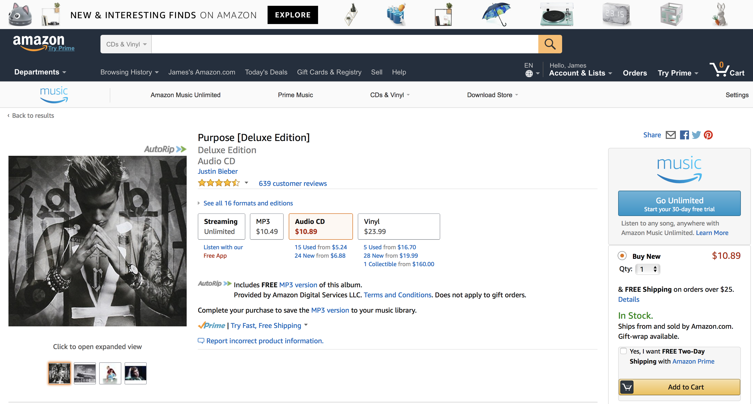

Slide 46
Choose your framework!
Angular modules
React components
Aurelia components
noun.js component

Slide 47
Frameworks are coupling!
Especially Angular

Slide 48

Web Components
Web component
HTML
CSS
template
element
<toggle-button>Click Me!</toggle-button>

Slide 49
Web Components
cart component
catalog component
HTML
CSS
HTML
CSS
template
element
template
element
account component
shipping component
HTML
CSS
HTML
CSS
template
element
template
element

Slide 50
Backing services
cart component
Cart API
catalog component
HTML
CSS
HTML
CSS
template
element
CatalogAPI
template
element
account component
shipping component
HTML
CSS
HTML
CSS
AccountAPI
Shipping API
template
element
template
element

Slide 52
promos.html

Slide 53
promos.html
account.html

Slide 54
promos.html
account.html
images.html

Slide 55
promos.html
account.html
images.html
formats.html
stock.js
cart.js

Slide 56

Service Team
polymer-project.org
store.com
api.store.com
api.sales.store.com
api.orders.store.com
api.shipping.store.com
api.erp.store.com

Slide 57
Avoid cross-component chatter
It's a sign your boundaries are wrong

Slide 58
store.com
Browser
Server
Database

Slide 59
Story server-side is…a little messier
And it's highly dependent on your server-side stack

Slide 60
store.com
Model
Controller
View

Slide 61
store.com
Model
Controller
View

Slide 62
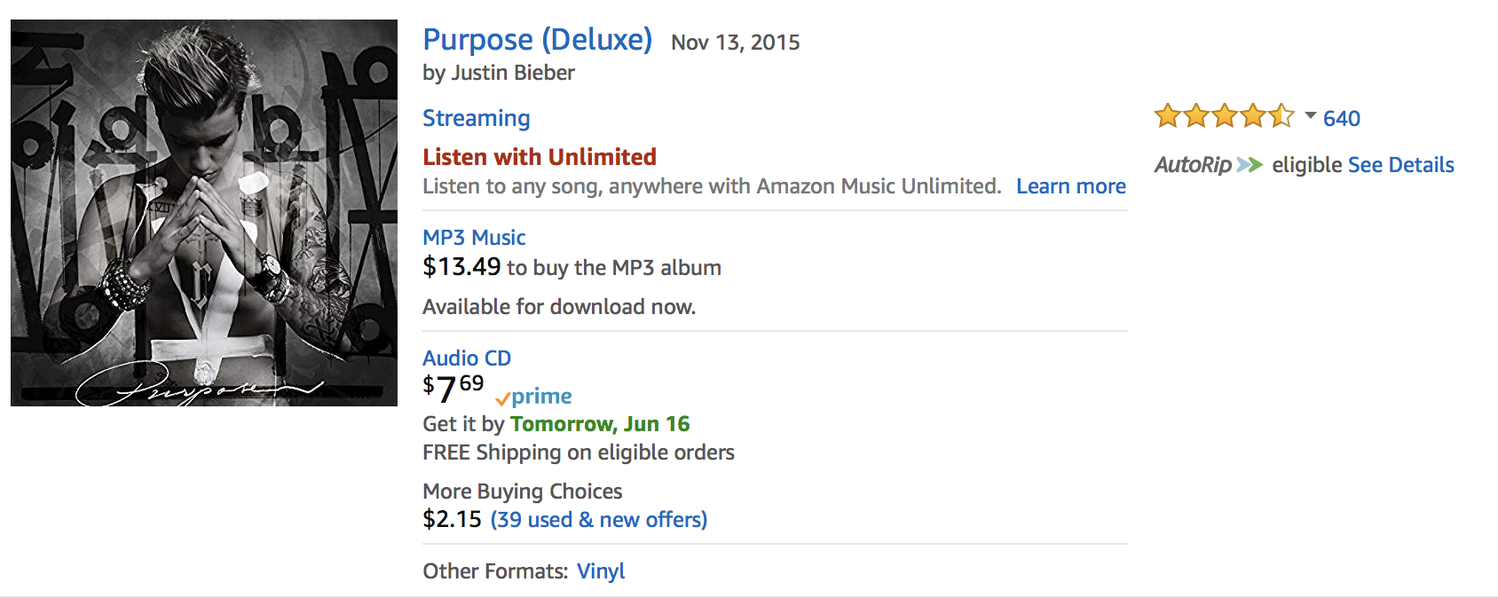

Slide 63
ProductSearchResult

Slide 64
ProductSearchResult
Product Catalog

Slide 65
ProductSearchResult
Product Catalog
Pricing

Slide 66
ProductSearchResult
Product Catalog
Pricing
Ratings

Slide 67
ProductSearchResult
Product Catalog
Pricing
Ratings
Recommendations

Slide 68
ProductSearchResult
Product Catalog
Pricing
Ratings
Recommendations

Slide 69
/products/search?q=…
Product Catalog
Pricing
Ratings
Recommendations

Slide 70
/products/search?q=…
Product Catalog
Pricing
Ratings
Recommendations

Slide 71
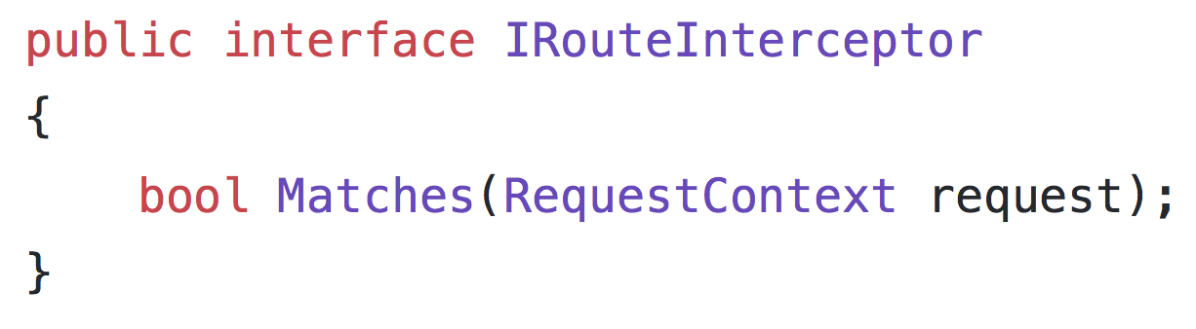

Slide 72
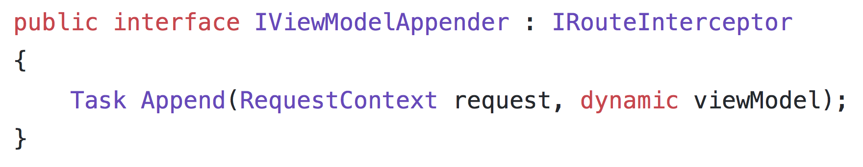

Slide 73
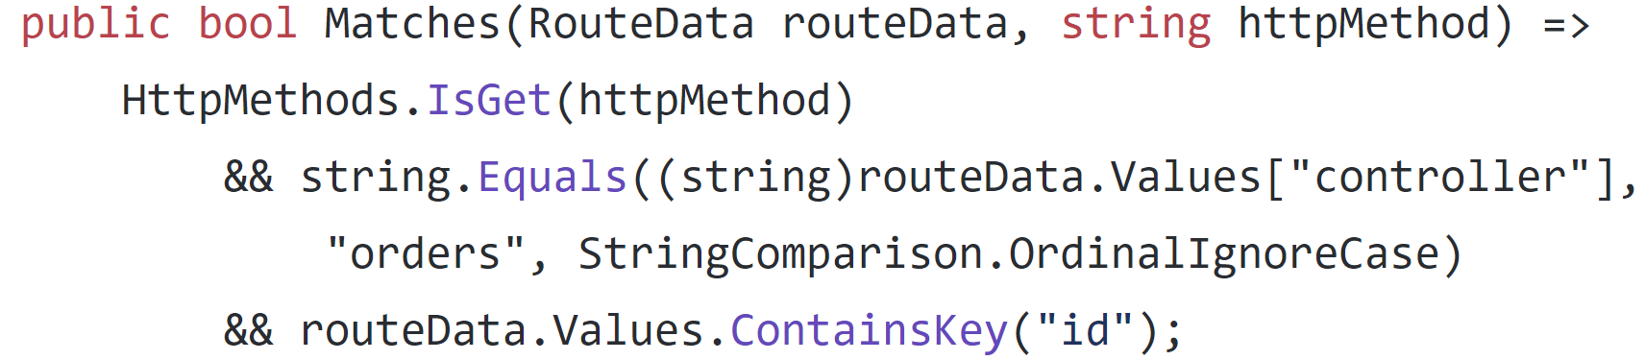

Slide 74
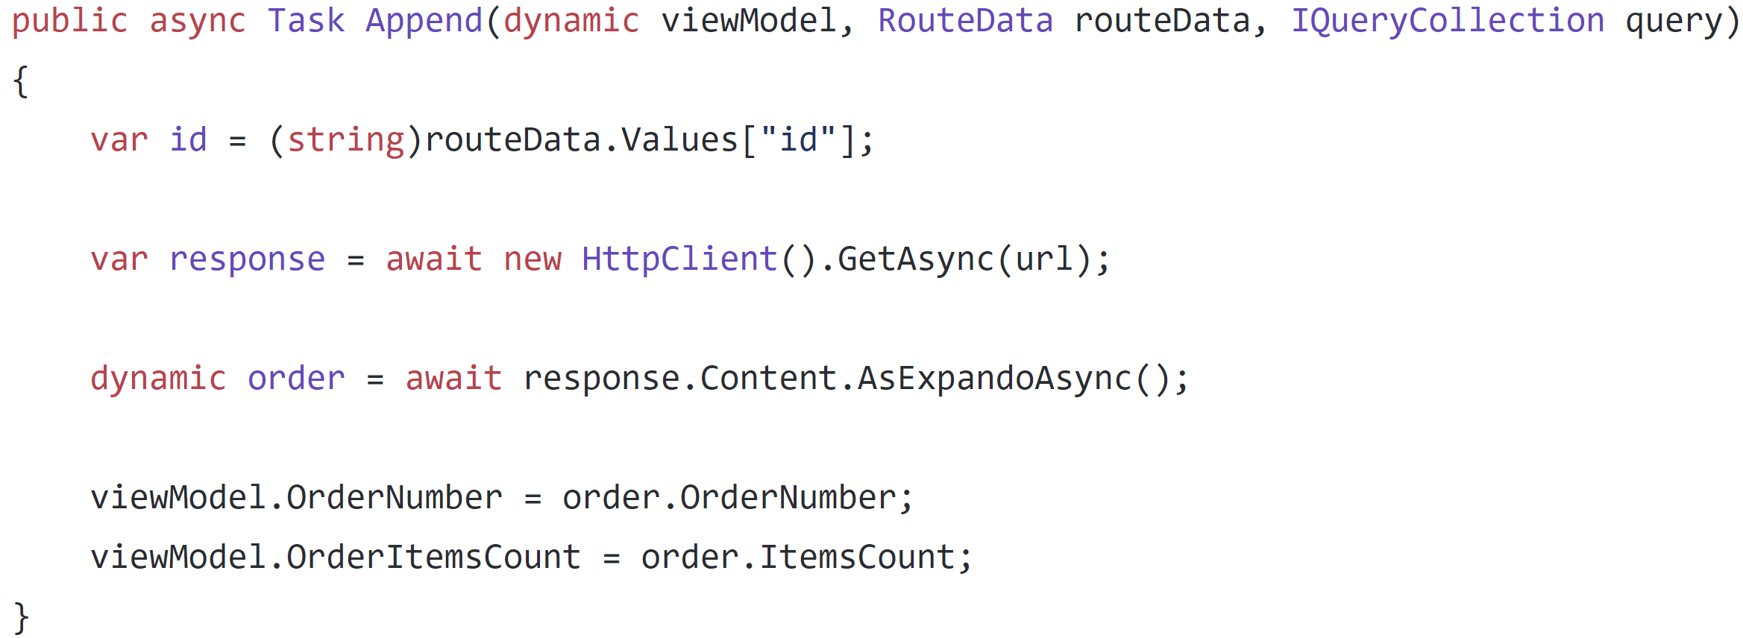

Slide 75
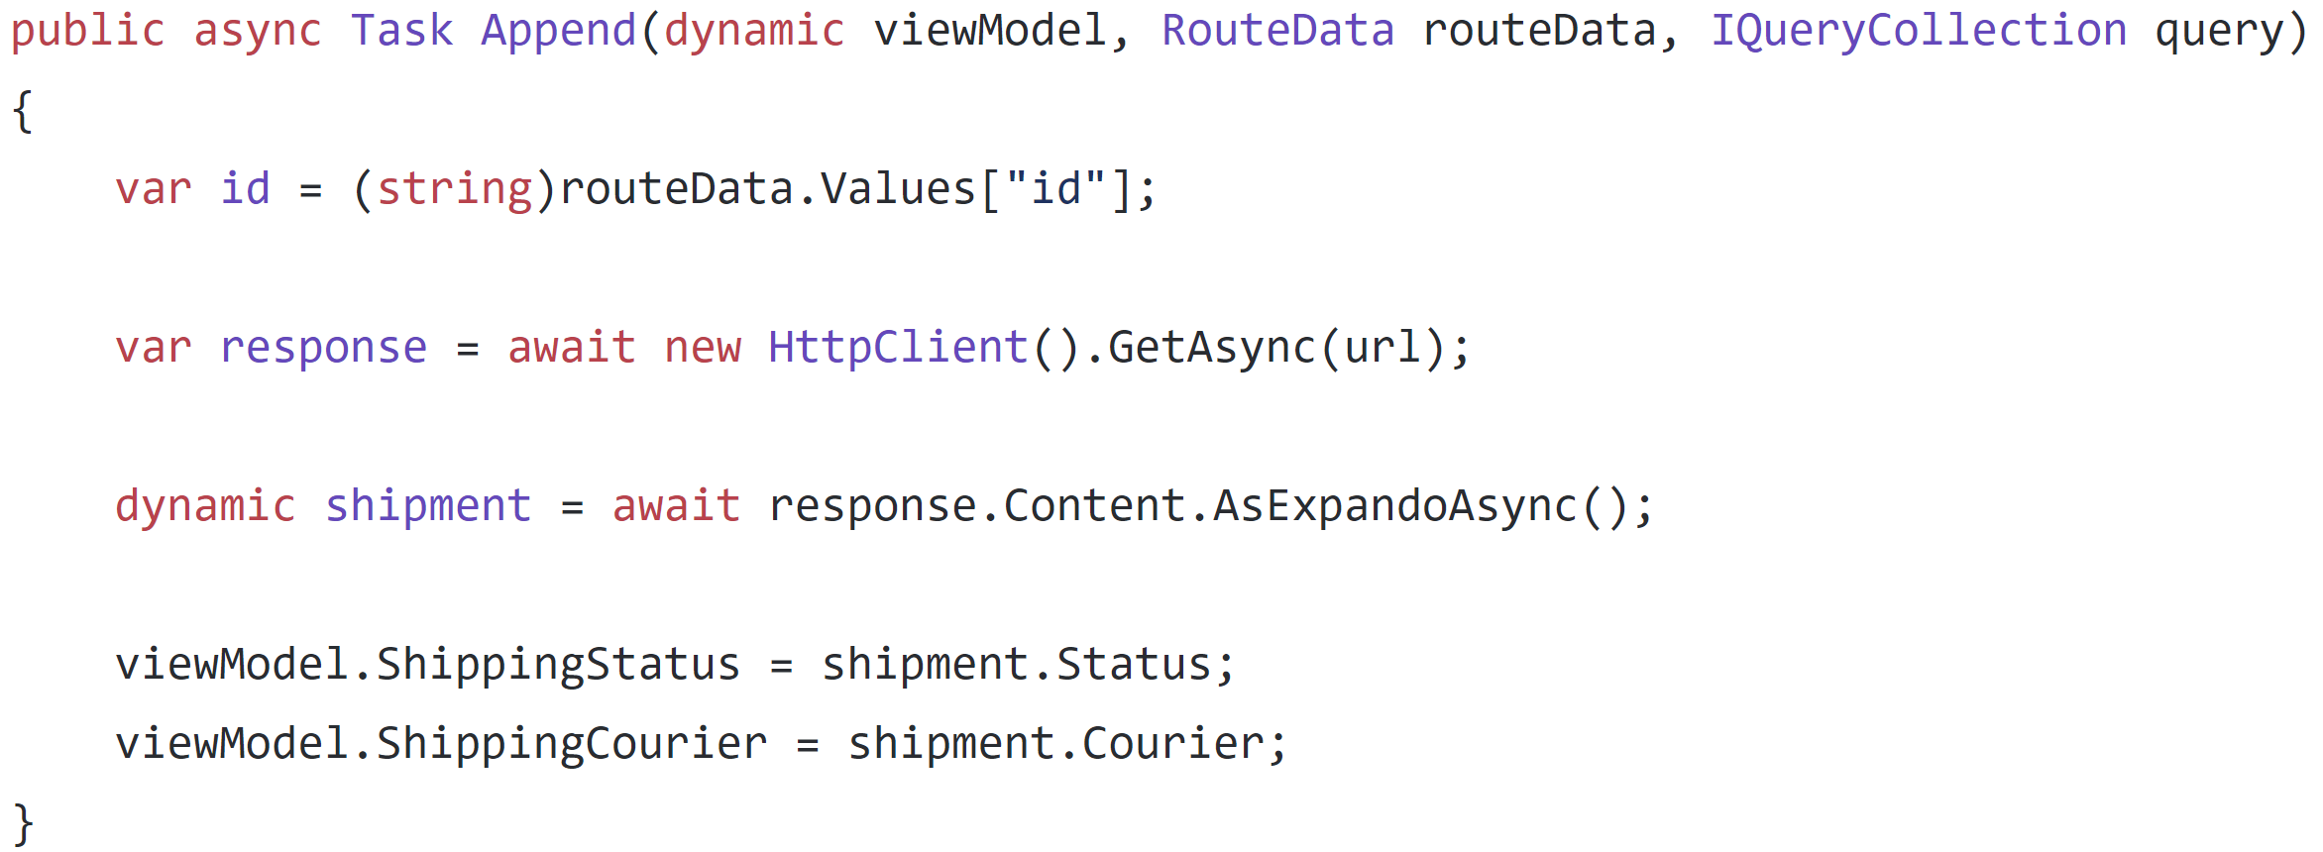

Slide 76
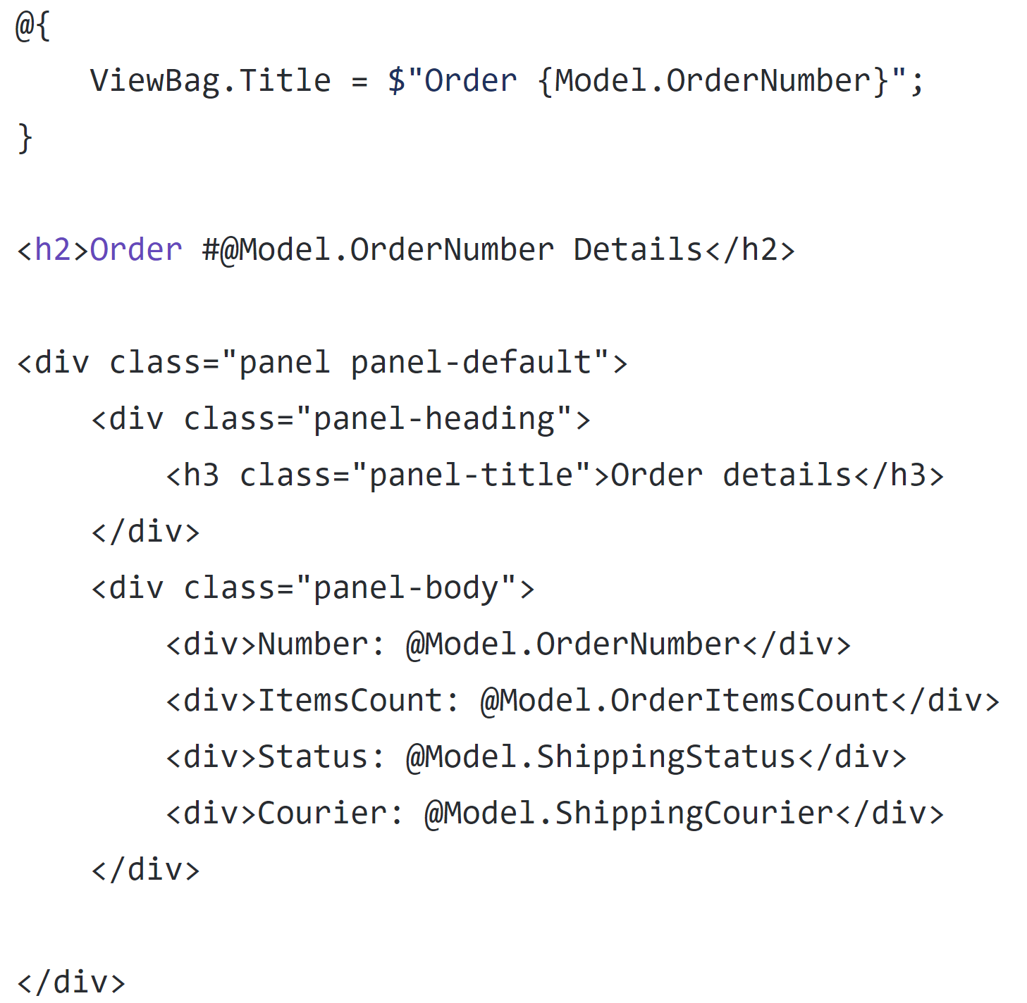

Slide 77
store.com
Model
Controller
View

Slide 78
promos.cshtml
account.cshtml
images.cshtml
formats.cshtml
stock.cshtml
cart.cshtml

Slide 79
ASP.NET Core: View components
Replacement for "child actions"
Encapsulate a mini-request, with invocation, model, and view
Can have parameters and business logic
Invoked from a view (usually a layout)

Slide 80
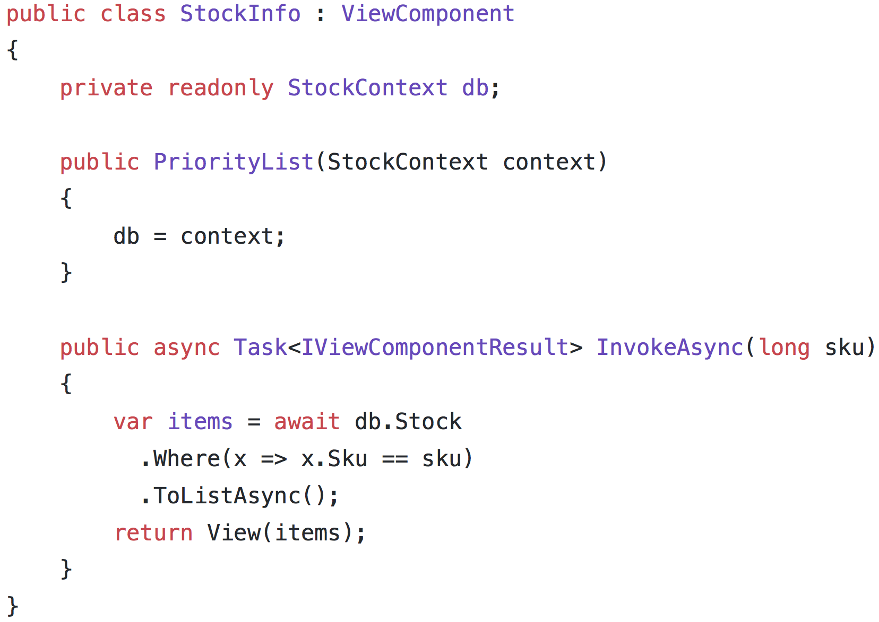

Slide 81
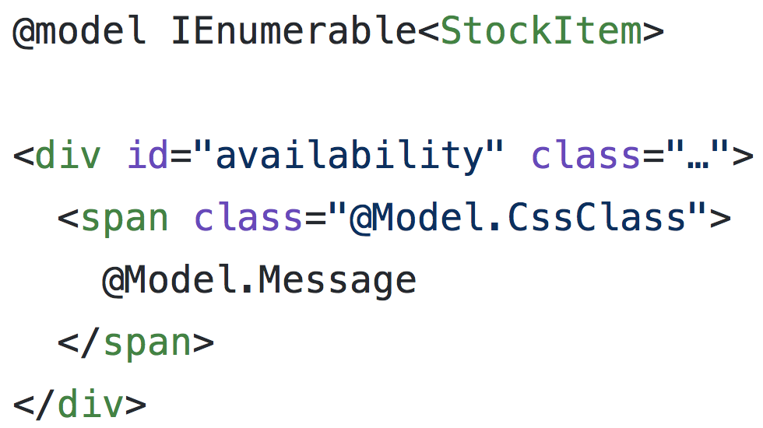

Slide 82
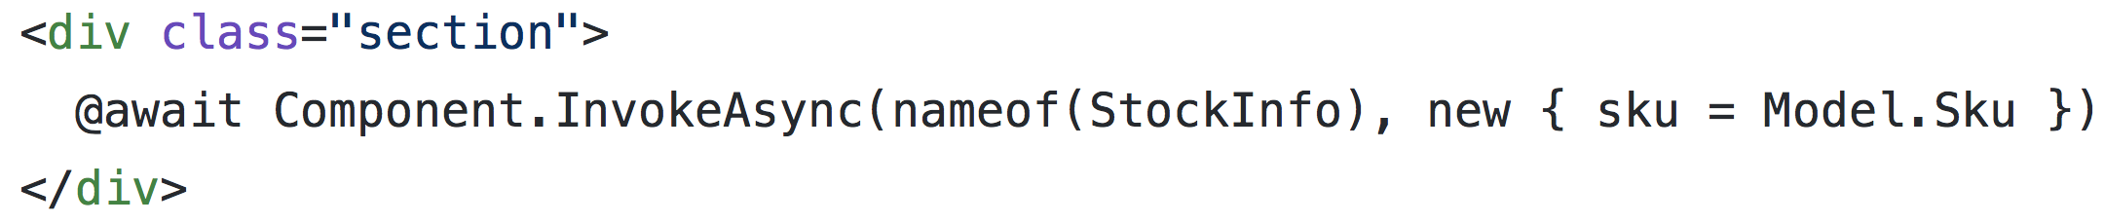

Slide 83
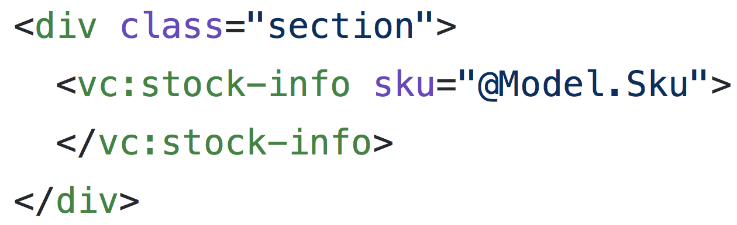

Slide 84
store.com
Browser
Server
Database

Slide 85
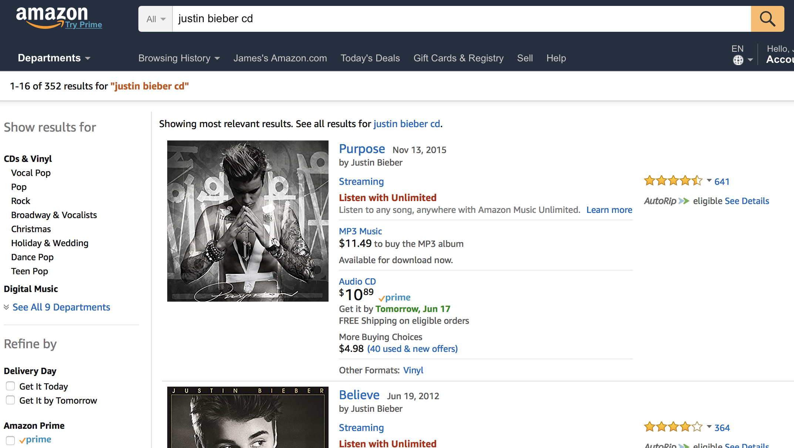

Slide 87
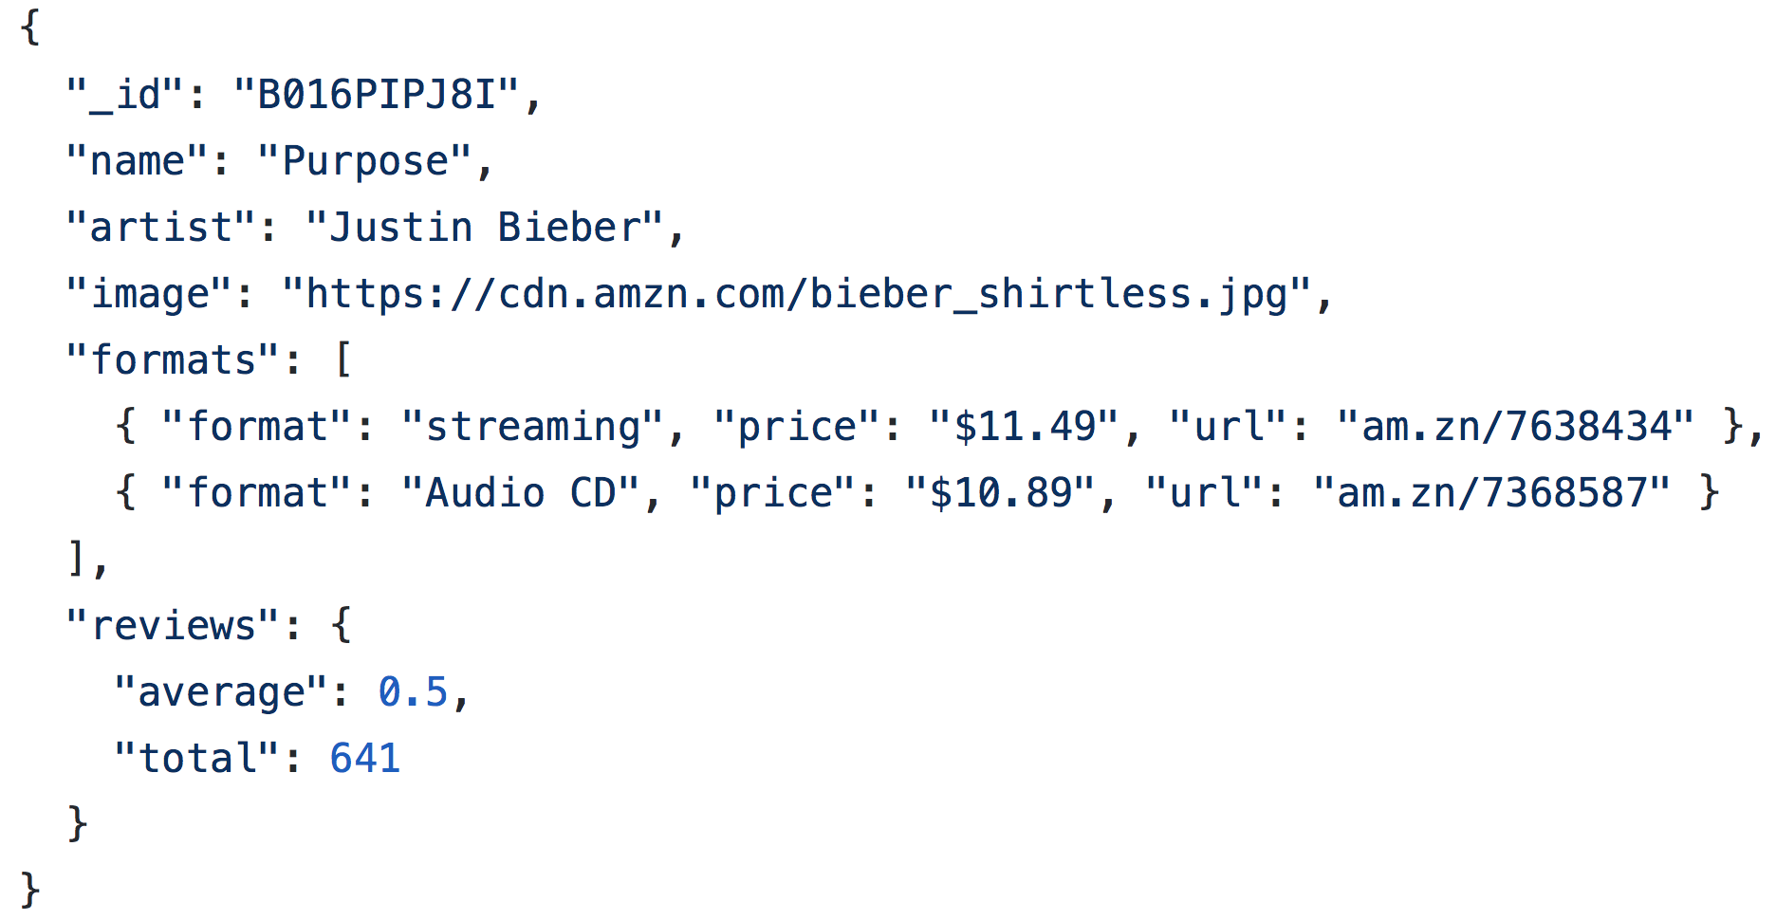

Slide 88
catalog.svc

Slide 89
catalog.svc
image.svc

Slide 90
catalog.svc
image.svc
formats.svc

Slide 91
catalog.svc
image.svc
formats.svc
reviews.svc

Slide 92
The Data Duplication Monster!!!

Slide 93
"Immutability changes everything" – Pat Helland

Slide 94
Data ownership
Search owns the shape of the data
Search owns the SLA of response
Search owns the relevance
But none of the data!

Slide 95
store.com Search
denormalizer
catalog.svc
image.svc
formats.svc
reviews.svc

Slide 96
store.com Search
store.com
denormalizer
catalog.svc
image.svc
formats.svc
reviews.svc

Slide 97


Slide 98
Rest API
Known quantity
1/day update
Search
API
Catalog

Slide 99
Images
Served with catalog
Sever connection
Search
Images

Slide 100
Formats
Rarely changes
Serves many internal clients
Existing integration method
Consume files 1/day
…
…
…
Search
Formats
DocDB

Slide 101
Reviews
Changes frequently
Important to react quickly
Triggers inside DB
Messaging to update
Search
Reviews
DB

Slide 102

Future State?
Reviews
Search
Catalog
Formats

Slide 103
Streams of Integration
HEAD
Catalog.ProductNameChanged
1
2
3
4
5
6
7
8
9
10
11
12
13
14
15
16
Search

Slide 104
Key Takeaways
Don't compose before it's necessary
Choose the compositional model based on what's best for the user experience
As always, the fallacies of distributed computing are called FALLACIES for a reason
Front-end can become its own service boundary

Slide 105
Composite UIs: The Microservices Last Mile
Jimmy Bogard
@jbogard
github.com/jbogard
jimmybogard.com

